Slide 1

NLP Analytics Pipeline Development
Call Transcription Analytics Using NLP

Slide 2
Pipeline Flow
Pre-Processing
Feature Engineering
Vectorization
Model Training/Evaluation
Predictions

Slide 3
Code Structure
Business Logic
Data Access Objects
Driver
Resources
Exceptions

Slide 4
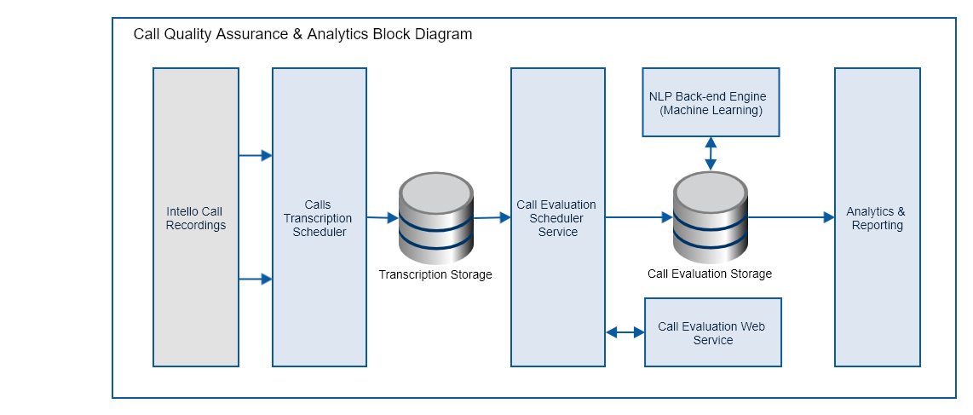
High Level Diagram

Slide 5
Module Composition
Service Classes
Abstract Classes
Handler Classes
Factory Classes
Implementation Classes

Slide 6
Expected Input
"transcript":
"text": "There is more snow coming to Montreal in the next few days.”,
"speaker": "1",
"start": 1.1,
"end": 18.5
[{
}]
"statistics":
[{
}]
"call_id": XXXX-XXXX,
"language": eng-USA,
"music": True,
"pitch": 4.5,
"frequency": 10.8,
"noise": 30%,

Slide 7
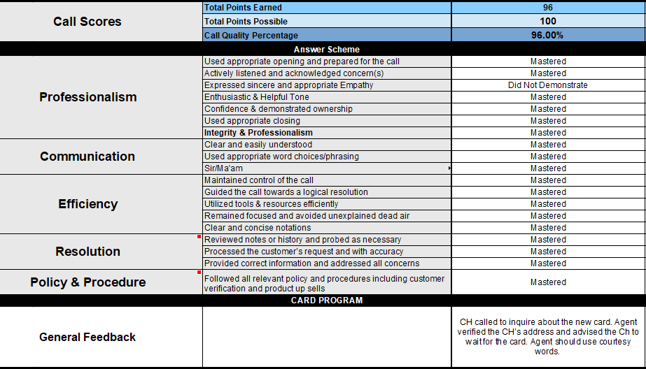
Expected Outcome

Slide 8
Detailed Discussion
An overview of the work done so far as well as our future goals

Slide 9
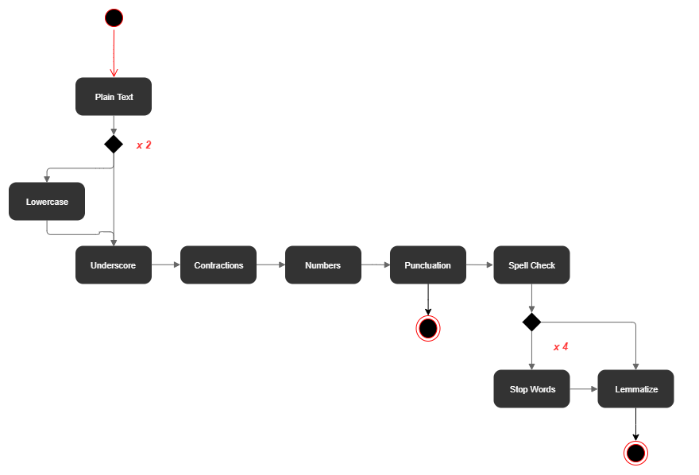
1. Pre-Processing
Transcribed Conversations needs to be cleaned in order to remove any sensitive information or noise from text.

Slide 10
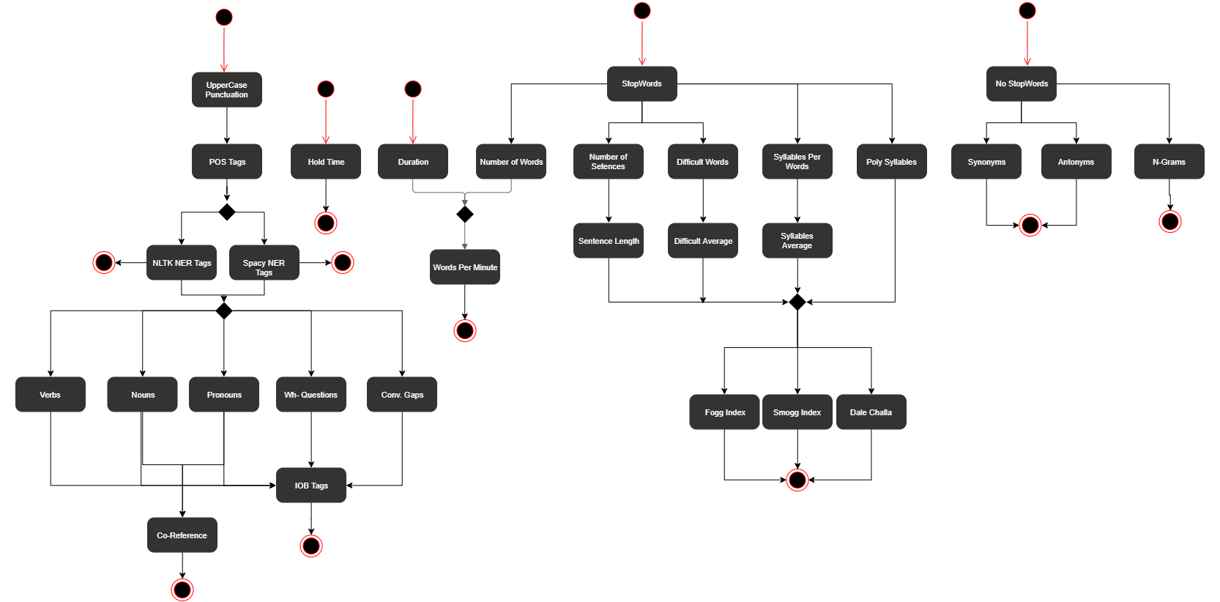
2. Feature Engineering
Types of features depend on our requirements for models: Tagging (POS, NER, DEP), Chunking (Nouns, Syn/Anto, Sentence Types, Intents), Difficulty Index, N-Grams and Gaps.

Slide 11
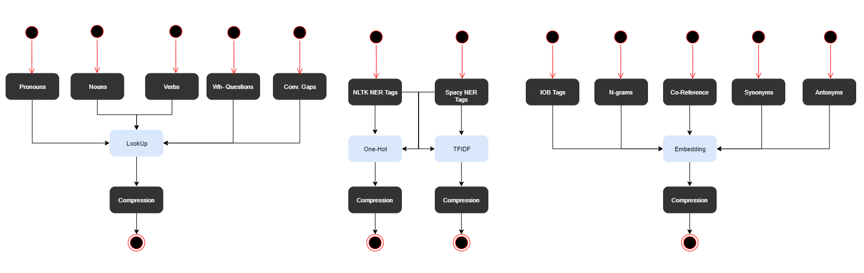
3. Vectorization
Different Types of vectors to be fed as input to different models: Lookup, One-Hot, Count, TFIDF and Embeddings (as well as their compressed forms such as: sparse vectors).

Slide 12
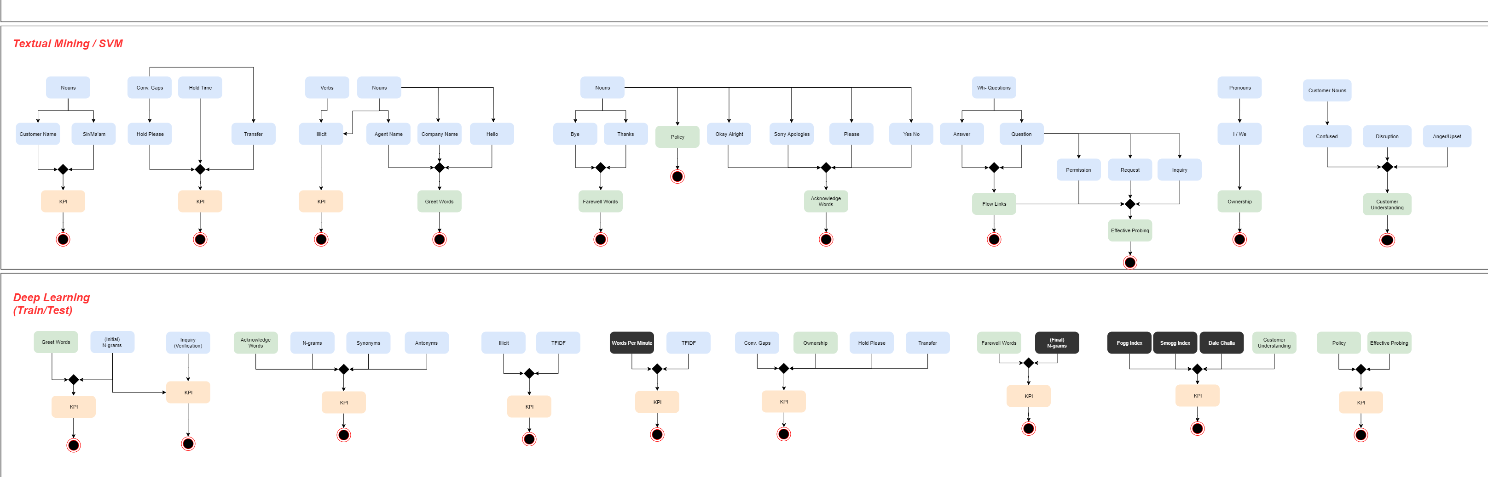
4. Model Training / Evaluation
Some are Machine Learning Models; some Features are results themselves and some are Deep Learning Models. No need to zoom in – we will be looking at them in close detail next.

Slide 13
KEY PERFORMANCE INDICATORS
Machine learning and deep learning models

Slide 14
Appropriate Opening and Prepared For Call
Useful Intents
Greetings
Self-Introduction
Company Introduction
Offer Help
Initial Verification
Other Input Features: NER Tags (PERSON, ORG, Nouns).

Slide 15
Appropriate Closing
Useful Intents
Bye
Thanks
Offer Help
Appreciation
NER Tags (Customer Name, CSR Name, ORG Name, Product Name).
Abrupt Call Endings:
Warning Scripts and End Call
Hold and End Call
End Call without Closing

Slide 16
Modelling
Use the aforementioned intents to train a classifer
Run a baseline based on the bag of words approach using Naïve Bayes.

Slide 17
Appropriate and Sincere Empathy
Positive Intents
Apology
Sympathy
Thank
Acknowledge
Courtesy
Good / Bad News
Request
Permission
Negative Intents
Blame
Demand
Refuse
Negate
Disappointment

Slide 18
Modelling
Use word embeddings to train a recurrent neural network
Train the networks separately for the card holder and the CSR and evaluate the sentiments against the corresponding dialogues.

Slide 19
Active Listening and Acknowledged Concern(s)
Acknowledgement - Useful Intents:
Acceptance
Acknowledgement
Agreement
Thank
Sympathy
Track Caller Inquiry – Useful Intents:
Inquiry
Question
Request
Dead Air between dialogues.
Co-reference Resolution, Topic Modeling and Noun Chunking for tracking human 'concern'.
Human Interruption still unaccounted for – can be catered through Interrupt Intent as well as if received as input from IVR as noise or shuffling.

Slide 20
4. Enthusiastic and Helpful Tone
Useful Features:
Words Per Minute
Speaking Rate
Word Difficulty Index
Tone is classically analyzed via Audio Pitch and Frequency (Fast Fourier Transforms) - if we attain access to these graphical representations of calls, we will think of using them as a feature to predict 'Appropriate Tone'.
Useful Intents:
Offer Help
Pardon
Prohibition
Complaint

Slide 21
Confidence and Demonstrated Ownership
Parts of Speech Tagging: Use of Pronouns (‘I’, ‘We’), Organization (‘Company Name’).
Disruption (‘Umm’, ‘Err’, ‘I’m not sure’).
First Call Resolution
Call Forwarding
Hard Hold / Pauses
Redirect to Website/Google
Confusion ('I don't know', 'let me call you back').
Useful Intents:
Confusion
Guilt
Confession
Obligation
Initiative
Promise
Confirm

Slide 22
Clear and Easily Understood
Difficult Index
Fogg Index
Smog Index
Flesch Reading Index
Dale Challa Readability
WPM and Speaking Rate
Noise
Useful Intents
Repeat
Confusion
Hesitate
Clear
Jargon

Slide 23
Efficiency and Call Flow
General Flow
Opening – Greeting, Introduction, Invitation, Permission, Offer Help
Closing – Courtesy (Thanks, Apologies), Advertise, Greeting, Rating
Statement – Question, Answer, Acknowledgment, Request, Order, Miscellaneous (Umm, Uhh)
Entities – Name, Date, Account Number, Illicit Language, Confidential Info, Query, Subject, Transfer, Hold, Sir/Ma’am
Semantics – Grammar, Emotions, Polarity, Tone, Empathy, Politeness
AIML (Artificial Intelligence Markup Language):
<aiml>: Defines the beginning and end of an AIML document
<category>: Defines the knowledge in a knowledge base.
<pattern>: Defines the pattern to match what a Caller may input.
<template>: Defines the response of an CSR to Caller’s input.

Slide 24
Used Appropriate Word Choices / Phrasing
Useful Intents
Swear Words (Fatal Criteria)
Rudeness
Sarcasm
Insult
Improper Grammar and Informal Sentence Structure (POS and Dependency Tags)
Use of Jargon (NER Tags)
Appropriate Probing:
Inquiry
Request
Permission
Confirmation
Information Retrieval
Verification

Slide 25
Natural Use of Customer’s Name and Avoided Excessive Sir/Ma’am
Personalization:
Named Entity Recognition (Customer Name)
Statements of Appreciation (You are our valued customer, I appreciate your time and efforts, …)
Pronoun Detection:
Sir/Ma'am Address Intent
Calculate Average Number of Sentences where Sir/Ma'am is used over Customer's Name – it shouldn't exceed beyond a set threshold.

Slide 26
Remained Focused and Avoided Unexplained Dead Air
Dead Air
Soft Hold (no longer than 8 seconds)
Used for Verification, Browser Load, etc.
Acceptable if used scarcely
Mute
Less than 3 seconds.
Used for coughing, fixing headset, etc.
Acceptable if used scarcely
Hard Hold
Press Hold key on Cisco and Music Plays.
Allowed up to 4 minutes.
Must avoid Dead Air by phrases such as 'Thank you for holding.'

Slide 27
Followed all relevant policy and procedures including customer verification and product up sells
Customer Verification
Dependent on DCFC Rules for Client
Access Code, Last Four Digits of SSN, Last 6 digits of Card Number, etc.
Additional Verification
Birthdate, Address, Secret Question, etc.
Product Up Sells
Client Script for CSRs
Related to Call Topic
Policy and Procedures
Not Allowed: Asking Full Card Number, PIN Number, etc.

Slide 28
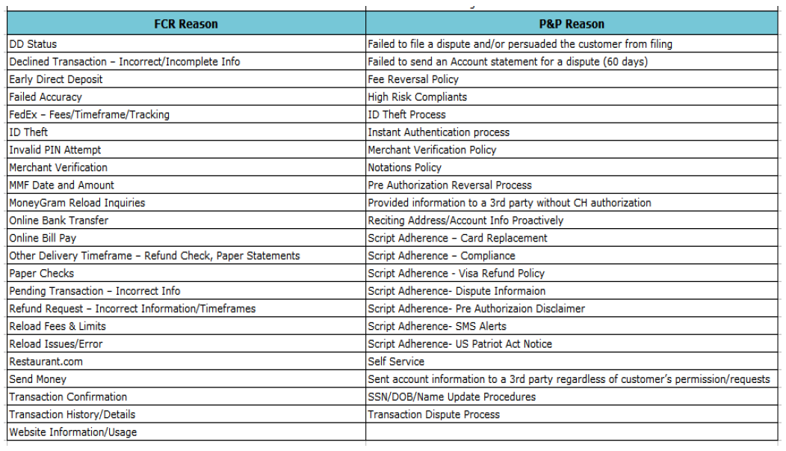

Slide 29
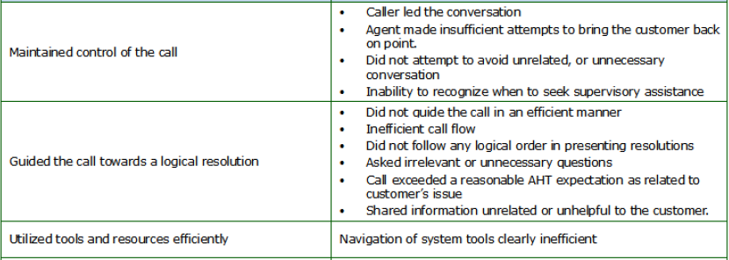
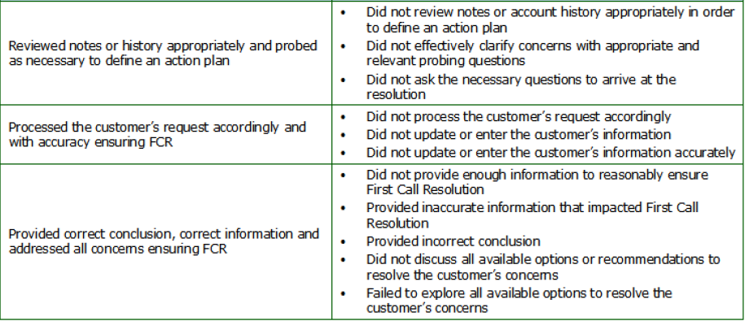
KPIs we are not looking at right now ...
We could use some expert help in this – or in the ones discussed before that may eventually help us solve these too!

